Slide 1

AI COMPILER
Discovering missed
compiler optimizations
LLM-guided experiments
for AscendNPU-IR
Experimental project proposal
16 October 2026
Notes:
Target and planning assumptions supplied by the user: AscendNPU-IR, Ascend NPU hardware, English, one engineer and part-time compiler-team support. The project uses ordered stages and provisional duration estimates. The pitch follows the Heilmeier questions. No customer experiments have been performed. Cover: generated conceptual illustration using the built-in image-generation tool, 15 October 2026. Prompt and provenance are in assets/provenance.md.

Slide 2
1 / GOAL
What are we trying to do?
Find optimization gaps with less
compiler-engineer time.
Run candidate search and experiments in the background.
Bring the AscendNPU-IR team reproducible findings to review.
Success means useful findings with less active investigation effort.
AI COMPILER / ASCENDNPU-IR
02
Notes:
Primary goal: reduce active engineer time spent searching for missed optimizations in AscendNPU-IR. Offload proposal generation, compilation, execution and evidence collection to a bounded offline framework. Time savings, finding yield and NPU performance benefits are hypotheses to measure. Execution latency is one possible evidence route; static report metrics remain under research. No target experiments have been performed.

Slide 3
2 / CURRENT PRACTICE
[REDO] How is this done today?
01
Locate expensive behavior
Connect a workload’s runtime cost to the relevant IR and generated code.
02
Establish a better alternative
Find a legal rewrite and determine whether its benefit survives compilation.
03
Prepare a compiler finding
Package the conditions, reproducer and measurements for developer review.
Typical workflow to confirm with the compiler team.
AI COMPILER / ASCENDNPU-IR
03
Notes:
Proposed customer workflow. A runtime bottleneck alone does not establish a legal compiler transformation. The pilot measures whether assisted investigation produces useful cases at an acceptable engineering and execution cost.

Slide 4
2 / CURRENT PRACTICE
Limits of current methods
Method | Limit relevant to this project
Profiling and inspection | Engineers connect runtime cost to a legal change.
Performance regression tests | Covered baselines can miss unrealized improvements.
Automated transformation search | Semantic coverage and cost models constrain the search.
The team’s actual investigation effort and pain points still need measurement.
AI COMPILER / ASCENDNPU-IR
04
Notes:
Typical limitations to assess with the customer. Profiling requires interpretation. Baseline comparisons cover the selected workloads and do not systematically identify improvements that the baseline never achieved. Automated search depends on its supported semantics, search space and cost model. The customer-specific effort and bottlenecks have not yet been measured.

Slide 5
3 / PROPOSED FRAMEWORK
What are we proposing?
01
Connect existing compiler and NPU tools
Adapters capture IR, compile variants, run output checks and collect measurements.
02
Offload the search
A controller runs bounded LLM experiments, retains feedback and stops poor searches.
03
Return evidence for compiler work
Reproducible cases with static evidence, optional timings and reviewable assumptions.
AI COMPILER / ASCENDNPU-IR
05
Notes:
An offline experiment framework for the AscendNPU-IR team. The product includes target adapters, bounded search, repeatable execution and an evidence store. Feedback is an internal search mechanism. The initial implementation uses one proposer and deterministic orchestration; it does not require the multi-agent architecture of PRAGMA.

Slide 6
3 / EVIDENCE
Why might this work?
 | LPO | PRAGMA
Task | Find replacement sequences in LLVM IR | Optimize generated kernels using profiling feedback
Reported result | 41 confirmed or fixed missed optimizations | 2.81× CPU and 2.30× GPU average speedup vs Torch
Important limit | No significant SPEC runtime gain for selected patches | Kernel results do not establish compiler fixes or NPU gains
Published results motivate an experiment. Ascend effectiveness remains untested.
Sources: LPO, arxiv.org/abs/2508.16125 • PRAGMA, arxiv.org/abs/2511.06345
AI COMPILER / ASCENDNPU-IR
06
Notes:
Sources: LPO v2, https://arxiv.org/html/2508.16125v2, especially Sections 4 and 5. PRAGMA v2, https://arxiv.org/html/2511.06345v2. Reported results are specific to each paper and are not comparable benchmarks. No NPU outcome is inferred.

Slide 7
3 / PROPOSED APPROACH
The hypothesis we will test
01
Useful alternatives
The model exposes missed simplifications or resource reductions after compilation.
02
Evidence guides further attempts
Diagnostics, static costs and optional runtime evidence guide further attempts.
03
Less active engineering work
Engineers spend less time preparing experiments and more time reviewing useful cases.
Background execution does not automatically reduce elapsed time or device use.
AI COMPILER / ASCENDNPU-IR
07
Notes:
Hypotheses, not established results: bounded LLM search proposes useful alternatives; feedback improves candidate selection; unattended experiments reduce active engineering effort at comparable finding quality. Device consumption and elapsed time are tracked separately.

Slide 8
4 / ASCENDNPU-IR TEAM
Who benefits if we succeed?
01
AscendNPU-IR optimization developers
Receive reproducible candidates for missing rewrites, pass interactions or missed triggers.
02
AscendNPU-IR performance engineers
Offload repeated proposals and runs; inspect a filtered set of supported findings.
03
Users of affected Ascend workloads
Benefit if the team implements and deploys the resulting compiler improvements.
Other compilers and general-purpose adoption are outside this experiment.
AI COMPILER / ASCENDNPU-IR
08
Notes:
The experiment is specifically for AscendNPU-IR compiler and performance engineers using Ascend NPU hardware. Portability to other compiler teams is a possible distant extension, outside the experiment and its success criteria. Compiler fixes require subsequent engineering and deployment.

Slide 9
5 / RISKS
[REDO] What could go wrong?
Risk | Response
Faster but incorrect code | Limit semantics and keep proof/test evidence distinct.
Assumptions the compiler lacks | Check every precondition at the chosen boundary.
Noise or gains that vanish in context | Reinsert the change and confirm on fresh runs.
Invalid proposals | Start small; use compilation and output checks.
Too few useful findings for the effort | Compare yield, device time and reviewer effort.
A running search loop alone does not establish practical value.
AI COMPILER / ASCENDNPU-IR
09
Notes:
The central risk is a functioning loop with too few useful compiler findings. Validation may dominate the work, particularly for custom memory and synchronization semantics. Model validity, measurement noise and reviewer effort also constrain feasibility. Each risk has an early resolving experiment in the supporting technical note.

Slide 10
5 / SCOPE CONTROL
Initial scope and limits
One IR boundary. One hardware configuration.
Candidate family | Example opportunity
Index and shape computation | Repeated arithmetic, address calculations or redundant checks
Data movement | Avoidable copies or materialization with explicit memory semantics
Choose one family first. Use static shapes and agreed numerical semantics.
Reserve separate workload families for evaluation.
AI COMPILER / ASCENDNPU-IR
10
Notes:
Proposed scope, to be agreed with the compiler team during scope selection. The two rewrite families are examples, not known AscendNPU-IR defects. Start with index and shape arithmetic if memory effects make data movement too difficult to validate.

Slide 11
6 / DURATION
How long could it take?
One experienced engineer with part-time compiler-team support.
Outcome | Elapsed time from project start
Narrow prototype for one family | 2–3 months
Evaluated pilot, including the prototype | 4–6 months total
Provisional estimates. They assume existing execution and checking infrastructure.
Re-estimate after the first stage.
AI COMPILER / ASCENDNPU-IR
11
Notes:
Provisional engineering estimates requested in the Heilmeier discussion. Assumes one engineer with compiler experience, part-time team support, a runnable toolchain, reference implementations and reliable NPU access. The evaluated pilot duration includes the prototype. Substantial new formal semantics requires a separate estimate. Re-estimate after the first stage, especially for a student learning MLIR and Ascend.

Slide 12
6 / ORDERED STAGES
Ordered implementation stages
Stage | Work | Completion evidence
1. Boundary | Capture, replace and replay IR | Original and manual variant execute
2. Harness | Static scores, outputs and corpus | Replayable evidence and check limits
3. Check contract | Inputs, tolerances and controls | Seeded mismatches are rejected
4. Search | LLM, feedback and experiment store | Bounded unattended attempts
5. Evaluation | Held-out cases and team review | Useful findings and active time costs
Research question: which findings need NPU timing, and which can be reported earlier?
AI COMPILER / ASCENDNPU-IR
12
Notes:
Proposed order without a handover stage. Initial output checks do not depend on a formal verifier. Stage 3 defines the observed outputs, selected inputs, tolerances and failure policy. An optional later checker audit must not block the first experiment.

Slide 13
7 / INTERMEDIATE CRITERIA
[REDO] Progress methodology
01
Define the evaluation cases
Separate known controls from unseen cases; decide what counts as one useful finding.
02
Make the comparison fair
Match tasks and checking rules; account for operator familiarity and search variability.
03
Measure the work that is offloaded
Log setup, interventions and review time alongside finding yield and device use.
AI COMPILER / ASCENDNPU-IR
13
Notes:
Requested for rework. These are methodological questions to resolve, not a finished evaluation protocol. Need a fixed case set, useful-finding definition, matched comparison and measurements of setup, intervention and review time.

Slide 14
7 / FINAL CRITERIA
What would count as success?
Claim | Evidence needed
Can discover useful gaps | A new AscendNPU-IR case with agreed correctness and improvement evidence, accepted by the team.
Can save engineer time | Comparable useful findings with less active setup, intervention and review time than the agreed baseline.
Report the time spent reviewing false positives and unsuccessful searches.
Static evidence can support a report; a runtime-gain claim needs execution timing.
AI COMPILER / ASCENDNPU-IR
14
Notes:
Proposed success criteria remain subject to the evaluation-methodology and metric-choice rework. A static report can count if the team accepts its improvement evidence and correctness contract; it cannot be called a demonstrated speedup. One useful case establishes feasibility, not engineer-time savings. Count distinct patterns; retain failures and review overhead. A production compiler change is not a required output of this experiment.

Slide 15
7 / COMPARISON TO DESIGN
How to test engineer-time savings
Measure | Current workflow | With the framework
Engineer effort | Prepare, run, diagnose and package experiments | Configure, intervene and review findings
Useful outcome | Distinct cases accepted by the AscendNPU-IR team | Same acceptance criteria
Other costs | Elapsed time and NPU consumption | Elapsed time, NPU use and model consumption
Compare useful findings per active engineer-hour; include failed attempts.
AI COMPILER / ASCENDNPU-IR
15
Notes:
Concrete interpretation of the experimental comparison; detailed methodology remains REDO on slide 13. Compare matched Ascend tasks, not the same already-solved case twice without accounting for learning. Counterbalance assignments if feasible. Record setup, intervention and review separately. Count initial framework development separately and show how reuse affects total effort.

Slide 16
REFERENCES
Research foundations
LPO
Discovering Missed Peephole Optimizations
with Large Language Models
arxiv.org/abs/2508.16125 • Compiler-gap discovery and checked rewrites
PRAGMA
A Profiling-Reasoned Multi-Agent Framework
for Automatic Kernel Optimization
arxiv.org/abs/2511.06345 • Profiling feedback and execution checks
AI COMPILER / ASCENDNPU-IR
16
Notes:
Primary references: Xu et al., LPO, arXiv:2508.16125v2, https://arxiv.org/html/2508.16125v2; PRAGMA, arXiv:2511.06345v2, https://arxiv.org/html/2511.06345v2. Figures reproduced with attribution on slides 19 and 20. Tool references follow at their point of use and in research/reuse-and-verification.md.

Slide 17
APPENDIX / ARCHITECTURE
[REDO] System architecture
Layer | Components | Responsibility
Customer adapters | IR, compiler, cost metrics, reference and runtime | Expose the target and its semantic contract
Experiment core | Case selection, LLM interface, validation and search control | Propose, check and compare bounded experiments
Evidence and review | History, minimization, reports and triage | Preserve reproducibility and classify useful findings
The controller owns acceptance rules. The LLM proposes code and hypotheses.
AI COMPILER / ASCENDNPU-IR
17
Notes:
Proposed architecture. The framework operates offline next to the compiler. A single model-facing loop is sufficient initially. Read-only source inspection identified candidate integration points. Exact capture, replacement and execution commands still require a working experiment. See research/source-observations.md. A full flow diagram and contracts are provided in output/technical-design.md.

Slide 18
APPENDIX / TARGET INTEGRATION
[REDO] Ascend integration points
Observed starting point | Work still required
HFusion and HIVM pipelines | Choose a stable IR boundary and replay path.
HIVM vector-add integration | Generalize compilation, arguments and device execution.
Documented msprof workflow | Check metric coverage and code-to-profile mapping.
Documented mssanitizer workflow | Check launcher support and instrumented behaviors.
Source evidence only. Tool availability and end-to-end execution still need testing.
AI COMPILER / ASCENDNPU-IR
18
Notes:
Read-only inspection of AscendNPU-IR revision c84826fdf3a8febd068f0675f0b2c24d5eed99b3. Sources: bishengir/lib/Tools/bishengir-compile/PassPipeline.cpp; bishengir/test/Integration/HIVM/VecAdd/README.md; docs/source/en/user_guide/compile_option.md; docs/source/en/user_guide/debug_option.md. Public project: https://github.com/Ascend/AscendNPU-IR. No compiler or hardware experiments were performed. The documented profiling and sanitizer route uses Triton; direct-IR launcher compatibility remains open.

Slide 19
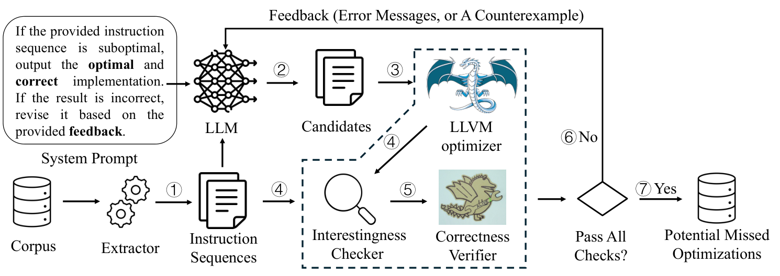
APPENDIX / PAPER REUSE
LPO: finding compiler gaps
Reuse: static screening before expensive checks. Target execution is not required by LPO.
Xu et al., LPO, Figure 2 • arxiv.org/abs/2508.16125
AI COMPILER / ASCENDNPU-IR
19
Notes:
Reproduced Figure 2 from Xu et al., LPO: Discovering Missed Peephole Optimizations with Large Language Models, arXiv:2508.16125v2, https://arxiv.org/html/2508.16125v2. Original image https://arxiv.org/html/2508.16125v2/workflow.png, unmodified. Figure describes LPO, not the proposed Ascend framework. LPO uses Alive2 for LLVM refinement and instruction count / llvm-mca cycle estimates for interestingness screening. It can record a potential missed optimization without executing the generated candidate on the modeled target. It still needs host compute, compiler tools, a scheduling model and model/solver resources. Static interestingness is not a demonstrated speedup. We borrow the search pattern; initial Ascend checks use compilation and observed outputs. Code reuse requires an artifact audit: https://github.com/uw-pluverse/lpo-artifact.

Slide 20
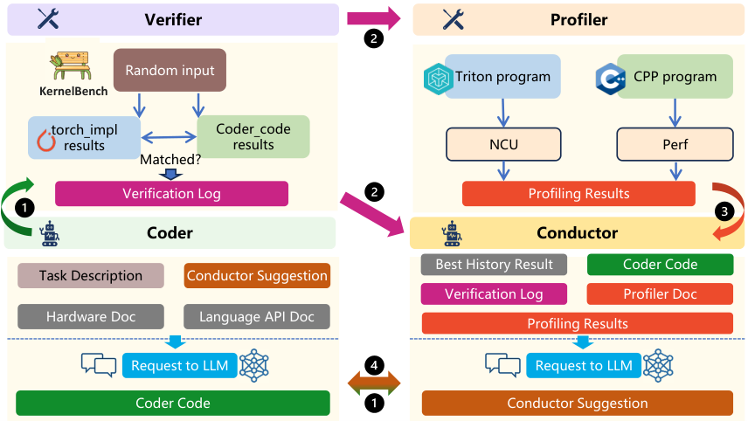
APPENDIX / PAPER REUSE
PRAGMA: using performance feedback
Reuse
Output comparisons
Profiles with context
Variant history
Adapt
Ascend measurements
Compiler-gap attribution
PRAGMA, Figure 1 • arxiv.org/abs/2511.06345
AI COMPILER / ASCENDNPU-IR
20
Notes:
Reproduced Figure 1 from PRAGMA: A Profiling-Reasoned Multi-Agent Framework for Automatic Kernel Optimization, arXiv:2511.06345v2, https://arxiv.org/html/2511.06345v2. Original image https://arxiv.org/html/2511.06345v2/overview-pgaikg.png, unmodified. This figure describes PRAGMA, not an implemented Ascend design. PRAGMA compares execution outputs and uses CPU/GPU profiling. We borrow the method; Ascend execution, profiles and IR attribution require new integration. Extra LLM agents are optional.

Slide 21
APPENDIX / VALIDATION
[REDO] Correctness and attribution
Preserve behavior
Establish compiler relevance
Types, shapes and layouts
Aliasing, effects and lifetimes
Integer and floating-point semantics
Invariants available at the IR boundary
Same compiler options and suffix
Benefit retained in the original operator
Start with output checks. General correctness remains a later review obligation.
AI COMPILER / ASCENDNPU-IR
21
Notes:
Proposed validation policy. Compiler verification checks well-formedness, not equivalence. Differential tests are limited to covered inputs. A formal checker can be used only for semantics it models. Changes to precision or floating-point evaluation require a pre-existing allowance.

Slide 22
APPENDIX / VALIDATION OPTIONS
Start with compilation and outputs
First iteration: compile, run and preserve the results we care about.
Fix the outputs, test inputs and numerical tolerances before search.
Reject compilation failures, crashes and observed mismatches.
Optional later tool | Potential use; coverage must be checked
MLIR-TV | Selected standard tensor operations
xdsl-smt | Small arithmetic subsets or explicit custom semantics
TensorRight | Generalized tensor rewrite rules in its own DSL
Passing tests supports a candidate finding; it does not prove equivalence for all inputs.
AI COMPILER / ASCENDNPU-IR
22
Notes:
Initial iteration accepts successful compilation and preserved observables on the agreed test inputs. Define outputs, side effects of interest, input seeds, dtype-specific tolerances and reference/baseline before search. Output tests still require execution even when timing is omitted. A fully hardware-free Ascend route needs a supported checker or interpreter, neither of which has been established here. Successful tests are empirical evidence, not a universal equivalence proof. Formal checkers are optional later additions, subject to operation coverage. Sources: https://github.com/aqjune/mlir-tv; https://github.com/opencompl/xdsl-smt; https://github.com/ADAPT-uiuc/TensorRight.

Slide 23
APPENDIX / LPO’S VERIFICATION CHOICE
Why Alive2 appears in this proposal
01
LPO needs an independent correctness check
Alive2 checks whether a replacement refines the original LLVM IR.
02
AscendNPU-IR has a different semantic surface
HFusion/HIVM device operations are not automatically covered by Alive2.
03
A possible later extension
Use a justified LLVM export for a supported subset; begin with execution checks.
Sources: LPO, arxiv.org/abs/2508.16125 • github.com/AliveToolkit/alive2
AI COMPILER / ASCENDNPU-IR
23
Notes:
Alive2 is introduced because LPO uses it to check LLVM IR refinement. Sources: https://arxiv.org/html/2508.16125v2; https://github.com/AliveToolkit/alive2. It does not directly check arbitrary MLIR/HFusion/HIVM. A later optional route could export supported arithmetic to LLVM IR, but proof is conditional on preserved semantics and Alive2 coverage/bounds. Not required for the first iteration.

Slide 24
APPENDIX / VERIFICATION TOOLS
[REDO] Execution and proof tooling
Mechanism | Role and limitation
MLIR SMT dialect | Build solver queries. Target semantics still need encoding.
Reference execution | Compare outputs for tested inputs under an agreed contract.
IR verifier and sanitizer | Check structure and supported runtime fault conditions.
Validation record | Separate tested, proved, failed, unsupported and timed-out cases.
First iteration uses compilation and output checks; other tooling remains optional.
AI COMPILER / ASCENDNPU-IR
24
Notes:
Sources: https://mlir.llvm.org/docs/Dialects/SMT/; https://openxla.org/stablehlo/reference?hl=en; https://github.com/Ascend/AscendNPU-IR, docs/source/en/user_guide/debug_option.md. SMT is infrastructure for encoding formulas, not automatic custom-dialect semantics. StableHLO interpretation requires a supported program or justified mapping. Tests and sanitizer runs cover observed executions, not universal equivalence. Initial device-memory rewrites require explicit effect and synchronization contracts.

Slide 25
APPENDIX / METRIC CHOICE
[RESEARCH] Must the metric be time?
Evidence | Cost and claim
Static code / resource changes | No target execution for scoring. Shows simplification or reduced allocation; speedup remains unknown.
Target cost estimate | Needs a credible NPU cost model. Predicts benefit; model coverage and ranking need evaluation.
Execution latency | Needs runnable cases, device access and repeated measurements. Confirms speed for tested conditions.
Can static reports save resources while retaining value for the compiler team?
LPO: arxiv.org/abs/2508.16125 • Correctness checks are a separate requirement.
AI COMPILER / ASCENDNPU-IR
25
Notes:
Open question: must every report include NPU timing? LPO Section 3.3 uses instruction count and llvm-mca cycle estimates for interestingness, followed by Alive2. Source: https://arxiv.org/html/2508.16125v2. Proposed Ascend options below have not been evaluated. Static operation counts can misrank target cost; estimated traffic needs explicit shape, layout and execution assumptions. Runtime timing is required for runtime-gain claims, not automatically for every useful compiler report. Output testing still needs execution.

